Slide 1
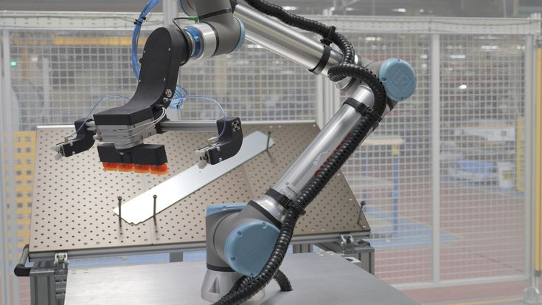


A General Design Analysis of Cobot Manipulators
ME6101 Final
Shubh Raval

Slide 2
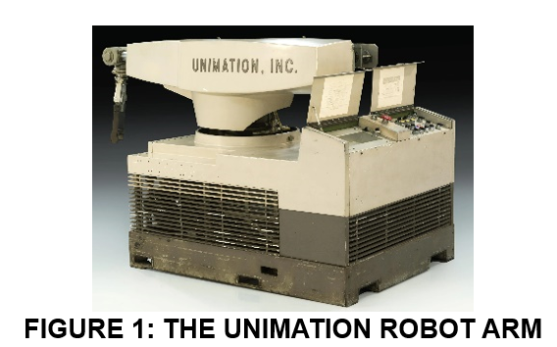
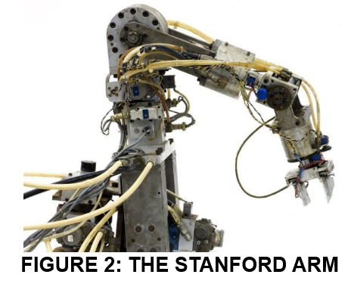
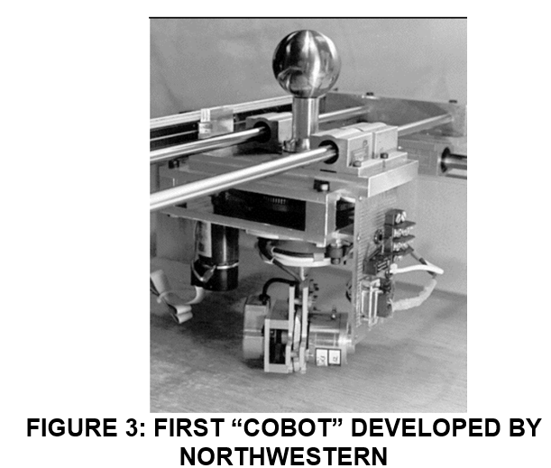
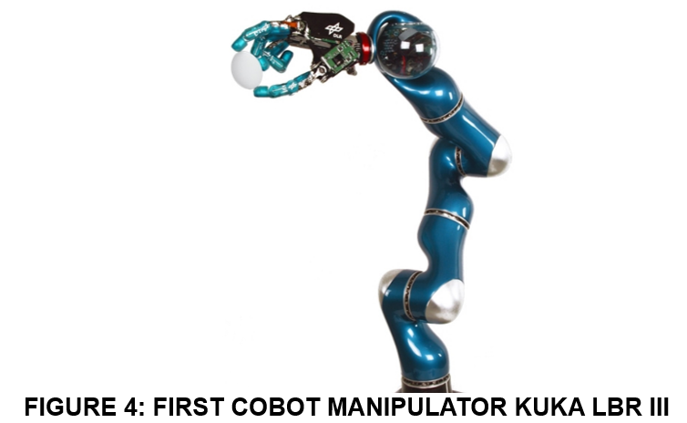
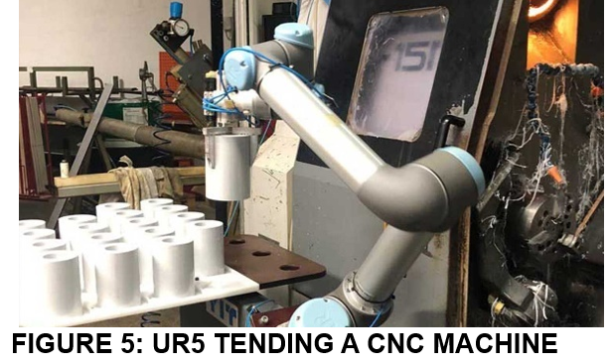
A History of Cobot Development

Slide 3
Overall Goal of Analysis
Understand the design of a cobot on a fundamental level
Why certain components are needed, what functions do they serve and how does that impact customers
Conduct functional modeling to develop a general cobot
Use Axiomatic Modeling to further develop general cobot
Qualify the Universal Robot as a good reference point for a general cobot’s design
Understand how a product line of cobots is thus created

Slide 4
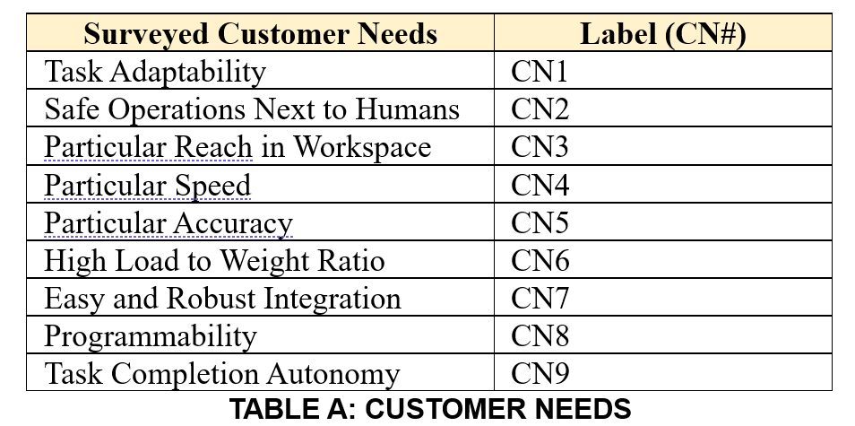
Tabularized CNs
Determined by evaluating top priorities from some customers/ robotic arm resellers
Determined by what the topic marketing topics were from cobot makers

Slide 5
Functional Modeling
This is a look at what is a general cobot and how can that be defined

Slide 6
Black Box Model
Material for Tasks
Transformed Materials
Perform Tasks
Electrical Energy
Acoustic Energy
Thermal Energy
Commands
Feedback
This is to show the most basic level that a cobot can be
At any point for any customer this is the basic model of what goes in, happens, and comes out of cobot

Slide 7
Function Structure Diagram
With the black box model created there is an ability to break that down to analyze the inner workings of the model
Material for Tasks
Import materials for tasks
Transform materials with rotation of cobot
Import Commands
Convert Mechanical energy to Rotation of cobot
Export transformed materials
Transformed materials
Commands
Transform Commands to Electrical Inputs
Export Acoustic Energy
Acoustic energy
Convert Mechanical Energy to Acoustic energy
Export feedback
Feedback
Convert Electrical Energy to Mechanical Energy
Export Acoustic Energy
Acoustic energy
Import Electrical Energy
Convert Mechanical Energy to Thermal Energy
Electrical energy
Convert electrical energy to Thermal Energy
Export Thermal Energy
Thermal energy

Slide 8
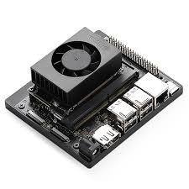
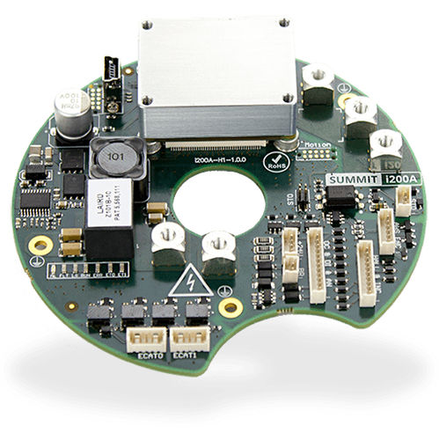
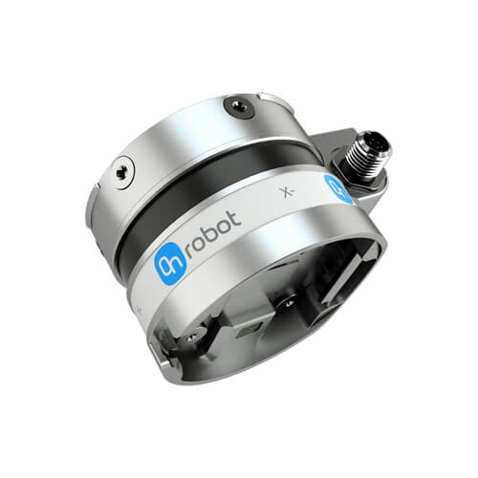
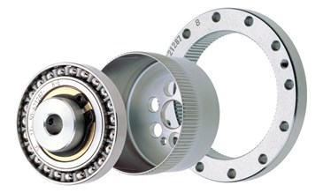
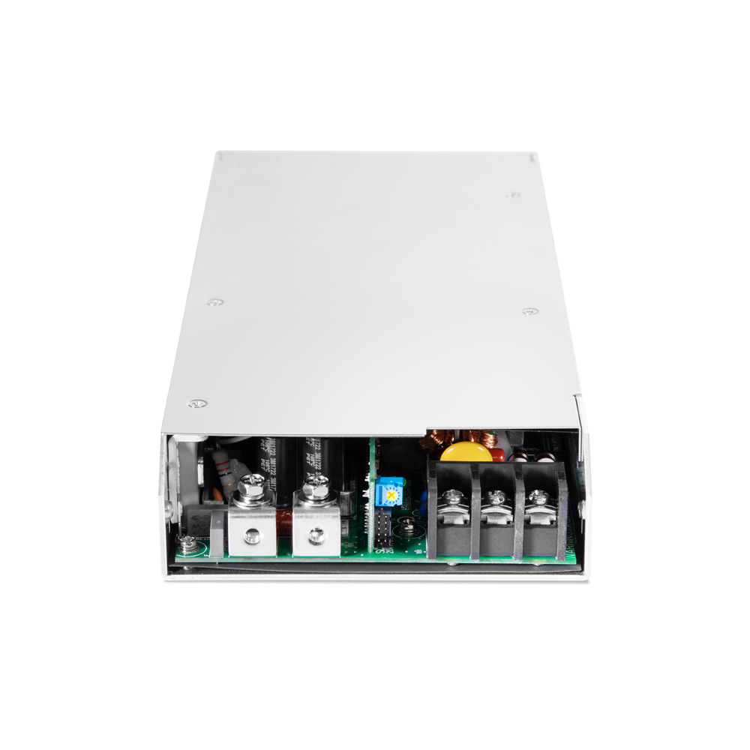
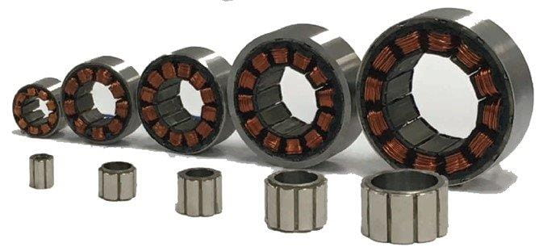

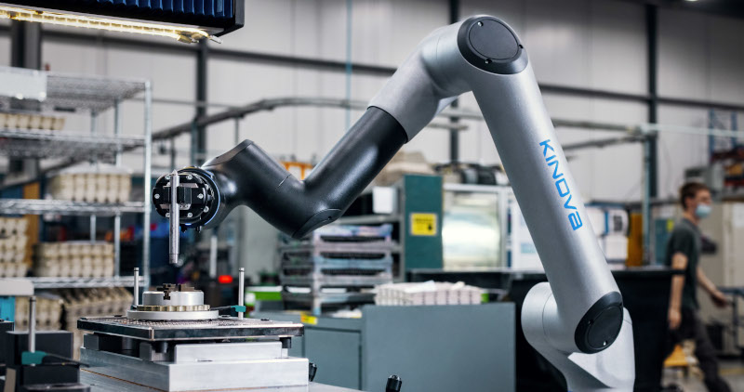
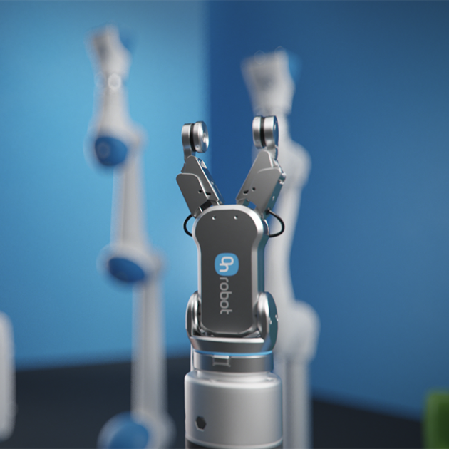
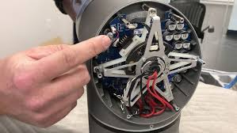
Modern Cobot Components Review
ONBOARD COMPUTER
MOTOR CONTROLLER BOARD
SENSOR SUITE
GEARBOX
POWER SUPPLY UNIT
MOTOR
LINKAGES STRUCTURE
SOFTWARE SUITE
END EFFECTOR
SAFETY SUITE/BRAKE

Slide 9
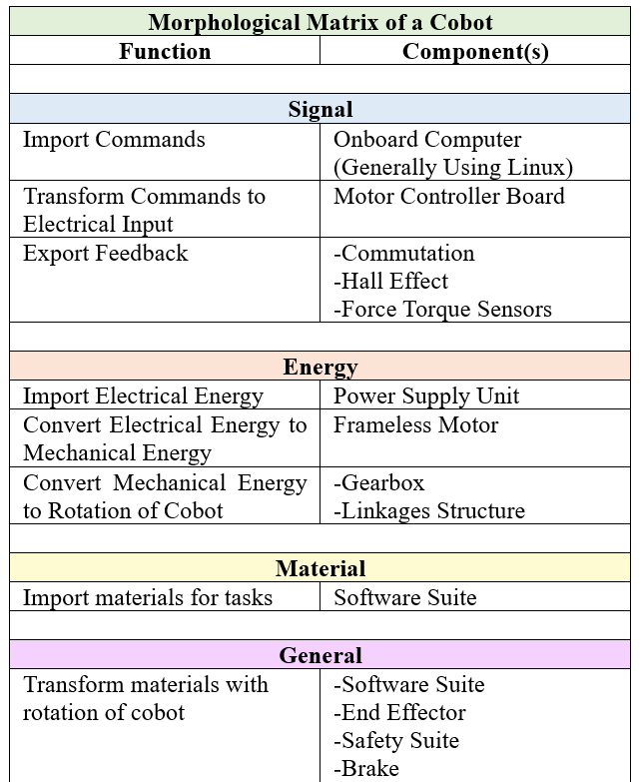
Morphological Matrix
After having completed the functional modeling, it comes time to assign components to those functions
For this initial point of reference the top cobot manufacturers were investigated to understand their component choice
What was found is that for major components as seen here they are largely the same
Thus completes the general cobot model which is essentially what the Universal Robotics Platform is

Slide 10
Axiomatic Analysis
This is essentially analyzing that same general cobot, which is qualified as the UR10e, from an axiomatic perspective to see if the same conclusions are drawn on the selected components

Slide 11
Customer Needs to Top Level Function Requirements
Next the customer needs are mapped to certain functions that are based on the functional modeling
Task adaptability
Safe operations next to humans
Particular reach in workspace
Particular speed
Particular accuracy
High Load to Weight Ratio
Easy and robust integration
Programmability
Task completion autonomy
Export feedback
Transform materials with rotation of cobot
Convert electrical energy to Mechanical energy
Import electrical energy
Import commands
Import materials for tasks
Transform commands to electrical input

Slide 12
Deep Dive on the hierarchy of 2 Functional Requirements
The functional requirement of export feedback and transform materials with rotation of cobot are very complex as seen by them singularly satisfying more than half of the customer needs
Hence it is critical to break down both functional requirements and then relative them to their respective physical domains
This should produce the expected zigzag which is a hall mark of the hierarchical descent in axiomatic analysis

Slide 13
FR1 – Export Feedback
FR1
Payload Sensing
Collision Detection
Tip-Position Feedback
Motor Feedback
{FR14}
{FR11}
{FR12}
{FR13}
Stopping Ability
{FR121}
Motor Effort Feedback
Motor Velocity Feedback
Motor Position Feedback
{FR141}
{FR142}
{FR143}

Slide 14
DR1 – Sensor Suite
DR1
{DR11}
Load Sensing
{DR12}
Collision Field
{DR13}
Cascaded Motor Positioning Feedback
Motor Sensors
{DR14}
Load Cell
Cantilever Strain Gauge
6-axis Force Torque Sensor
{DR111}
{DR112}
{DR113}
Current Sensor
Hall Effect Sensor
Digital Encoder
Software- Collision Field
Capacitive Touch Field
{DR121}
{DR141}
{DR142}
{DR143}
{DR122}
Brake
{DR1211}

Slide 15











Functional Requirements to Physical Domain Mapping {FR1->DR1}
FR1
DR1
DR11
DR12
DR13
DR14
FR11
FR12
FR13
FR14
FR121
DR121
DR1211
DR122
FR141
FR142
FR143
DR111
DR112
DR113
DR141
DR142
DR143

Slide 16
FR2 – Transform Materials with Rotation of Cobot
FR2
Manipulate Material Up to Payload Limit
Rotate Joints upto a Certain max Speed
Reach End Effector Position within certain precision
Remain Structurally Lightweight
End Effector Can interact with Materials
{FR24}
{FR25}
{FR21}
{FR22}
{FR23}

Slide 17
DR2 – Coordinated Joint Rotation
DR2
{DR21}
{DR23}
{DR25}
Use Mechanical Advantage
High Speed Motor
{DR22}
Software Control of Motor Coordinated Control
High Strength to Weight Linkage Material for long enough linkages
Modular End effector tip
DR24}
Frameless
Brushless Housed
Standard Hole Pattern
{DR221}
{DR222}
{DR251}
Custom Hole Pattern
Strain Based Gearbox
Belt Drive
Planetary Gearbox
Preprogrammed exact motor jogging
{DR252}
Aluminum
Carbon Fiber
{DR211}
{DR212}
{DR213}
{DR241}
{DR242}
{DR232}
Forward Kinematics, Inverse Kinematics, and Path Planning
{DR231}

Slide 18











Functional Requirements to Physical Domain Mapping {FR2->DR2}
FR2
DR2
FR21
FR22
FR23
DR21
DR22
DR23
DR24
DR25
FR24
FR25
DR221
DR222
DR242
DR241
DR211
DR212
DR213
DR231
DR232
DR251
DR252

Slide 19
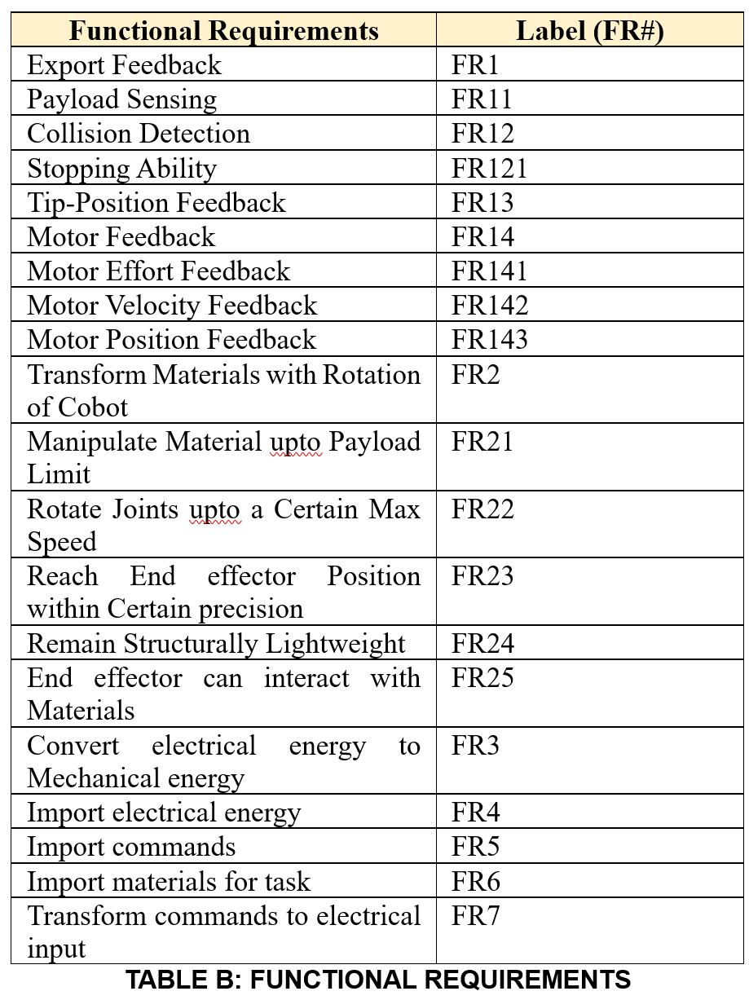
Tabularized FRs
This is the broken-down look at the axiomatic based functional requirements
Note the distinctions now created relative to the function structure diagram
Inclusion of Stopping Ability
Motor Feedback
Etc

Slide 20
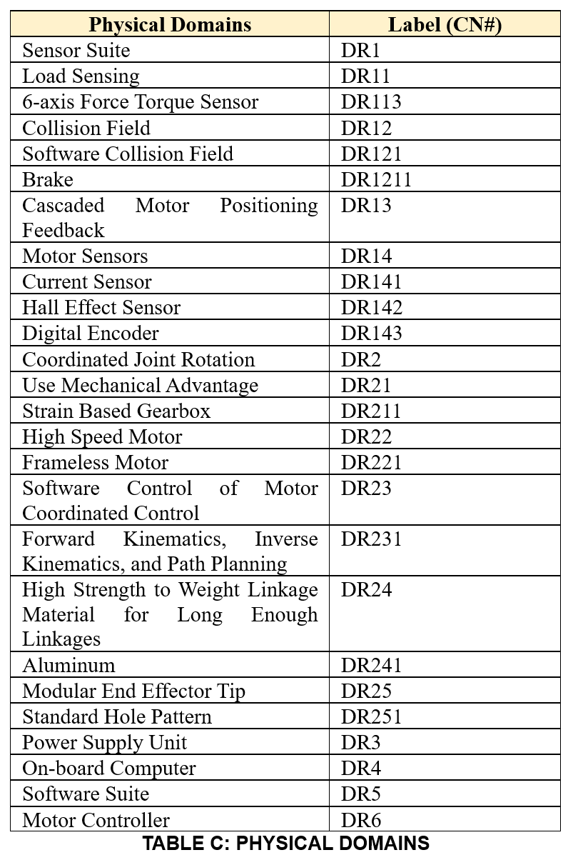
Tabularized DRs
This is the detailed look at the various physical parameters that need to address the functional requirements
Note the greater granularity relative to the morph matrix since this is attempting to quality that analysis’ results
Overall the components identified are largely similar just more fleshed out

Slide 21
Cascaded Domain Mapping
DR1
DR11
DR113
DR12
DR121
DR1211
DR13
DR14
DR141
DR142
DR143
DR2
DR21
DR211
DR22
DR221
DR23
DR231
DR24
DR241
DR25
DR251
DR3
DR4
DR5
DR6
FR1
FR11
FR12
FR121
FR13
FR14
FR141
FR142
FR143
FR2
FR21
FR22
FR23
FR24
FR25
FR3
FR4
FR5
FR6
FR7
CN1
CN2
CN3
CN4
CN5
CN6
CN7
CN8
CN9

Slide 22
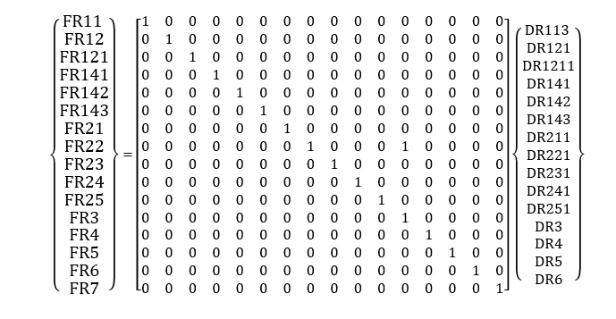
Independence Axiom
Overall the design is highly independent except for one, FR3, which relates to the motors since they also serve to exchange electrical energy to mechanical energy and generate velocity
Axiomtic Design Matrix :

Slide 23
Customized Product Line & Future Work
What can we glean from the axiomatic analysis about the Universal Robotics Product line and what more can be explored here?

Slide 24
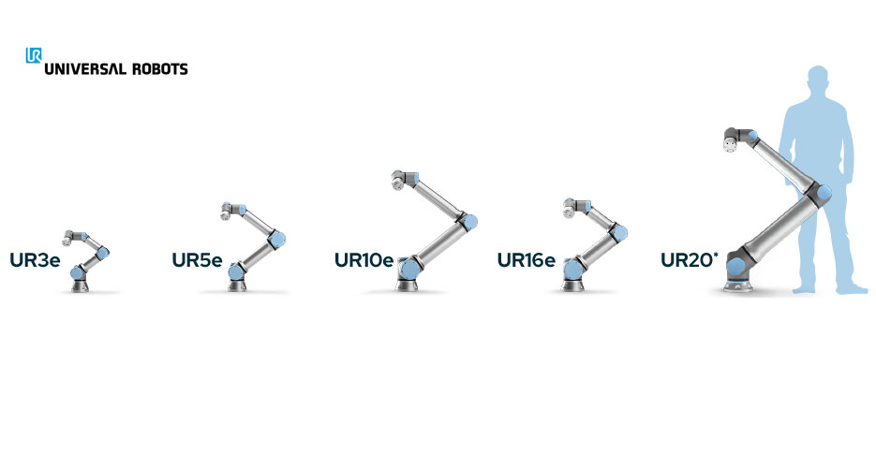
Product Family Customization
Most Important Components for Product Family Customization:
Frameless Motors
Strain-based Gearbox
Aluminum Linkages
One example of the critical component variation to develop product lines
UR10e and UR16e
UR16e has same motors but higher payload since it is shorter
1300mm vs 900mm and 10kgs vs 16kgs

Slide 25
Future Work
Now a deeper dive can be conducted by collecting real sales/customer data
This can be used with the information axiom to further evaluate the design
Additionally with the design parameters and the functional requirements they can be analyzed to see which is the most critical and are there more cost-effective ways to generate the same combination of products

Slide 26
Thank You!

Slide 27
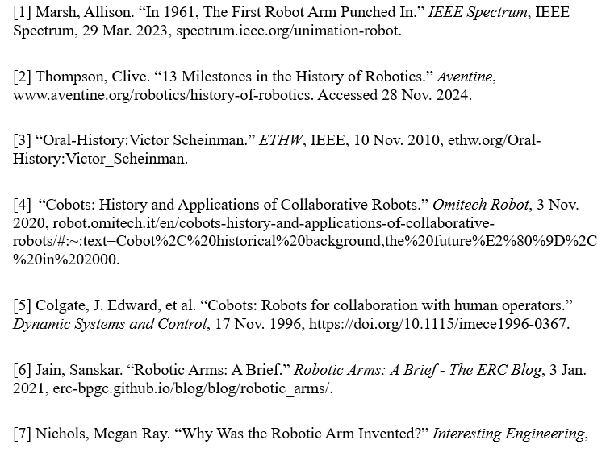
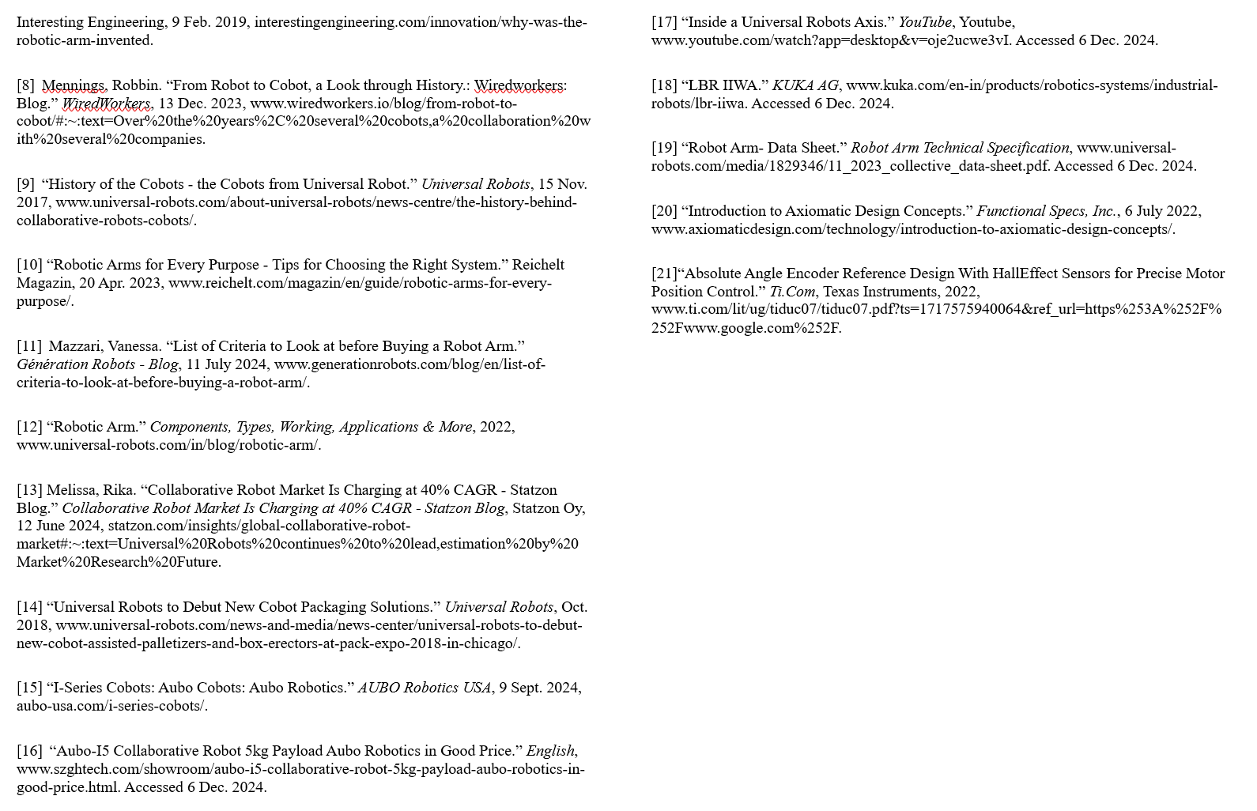
References

